Slide 1

OOP Based Application
By Shana Charlery

Slide 2
The Brief
The aim is to create an OOP based application. Here the incorporation of tools methods and technologies was implemented such as Yaml; and configuration tools such as Ansible.
Notes:
The application must made up of a total of 4 applications each with their own required elements. Each must be Flask based be able to control and alter data via at least one table with on functionality for the user to input data. This will also run on the Jenkins framework.

Slide 3
Solution
For my second project I created an application that require Docker. It was a Flask OOP orientated project via Jenkins framework. I create 4 separate services that would communicate with each other to form one application.
Notes:
- Talk about what each services do

Slide 4
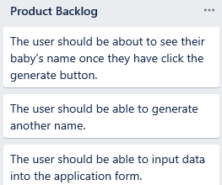
Requirements / Product Backlog
Notes:
- Talk about what you wanted for your application

Slide 5
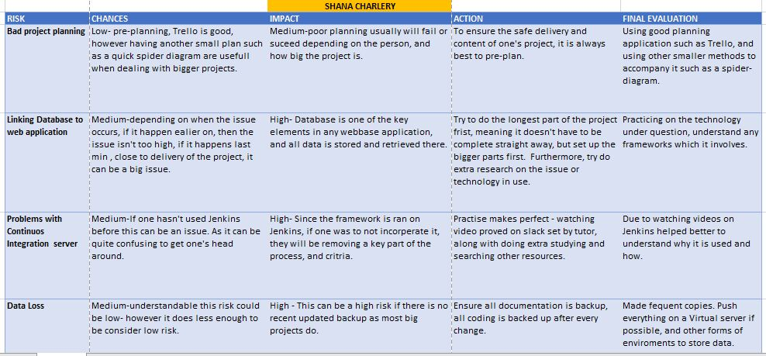
Risk Assessment Table

Slide 6
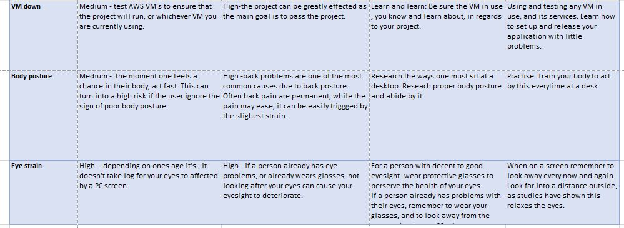
Risk Assessment Table

Slide 7
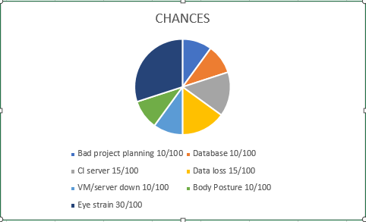
Pie chart risk
Notes:
- The chances as percentages

Slide 8
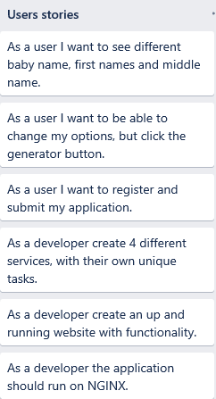
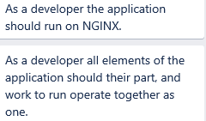
User Stories (Users and Developers)
Notes:
- Talk about images, what you'll like as a user and what you'll like as a developer

Slide 9
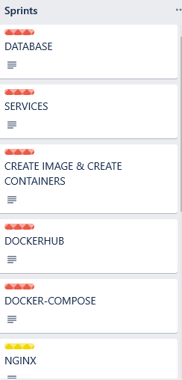
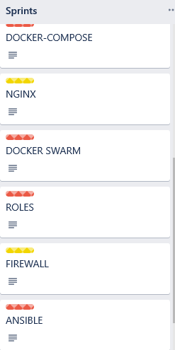
Trello Board (Sprint)
Notes:
- Talk about each sprint
- Talk about the coloured labels

Slide 10
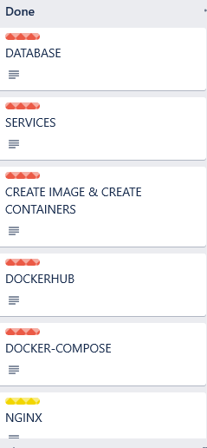
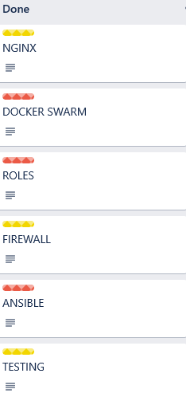
Trello to completion
Notes:
- All moved to Done

Slide 11
Jenkins & NGINX

Slide 12
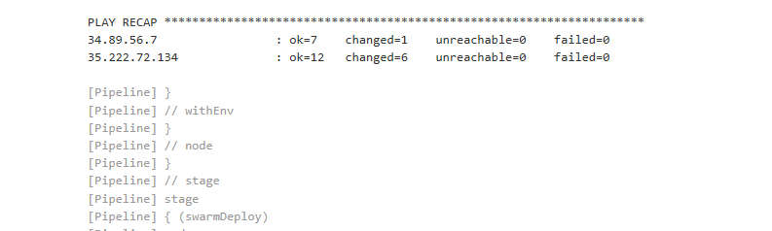
Manager and Worker part of swarm
Notes:
- running the tests you can see both have been added to swarm

Slide 13
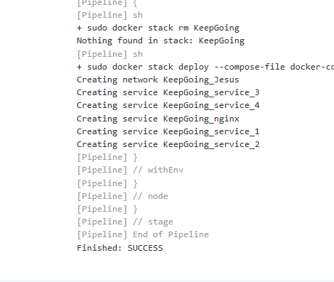
Jenkins build success

Slide 14
NGINX
Kanban board: NGINX
When running an application without NGINX the application has to be run on localhost, with port ':5000' as an extension to the servers external ipaddress.
Notes:
- Hosting your website on NGINX allows one to ditch the extension, and runs the website on port 80 where NGINX runs on.

Slide 15
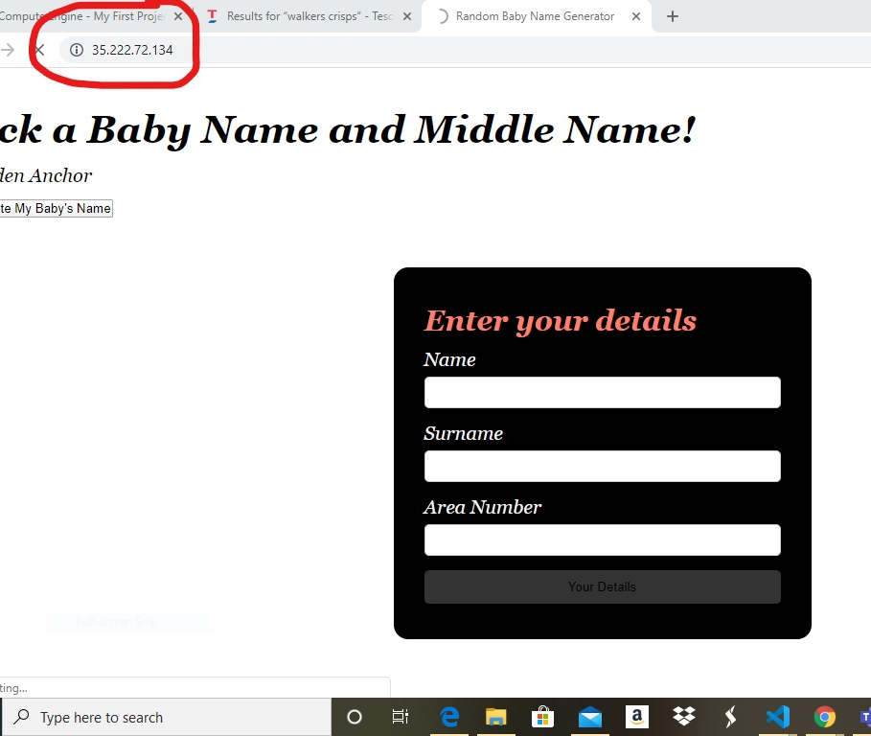
Master/Manager Node
Notes:
- Running on Nginx

Slide 16
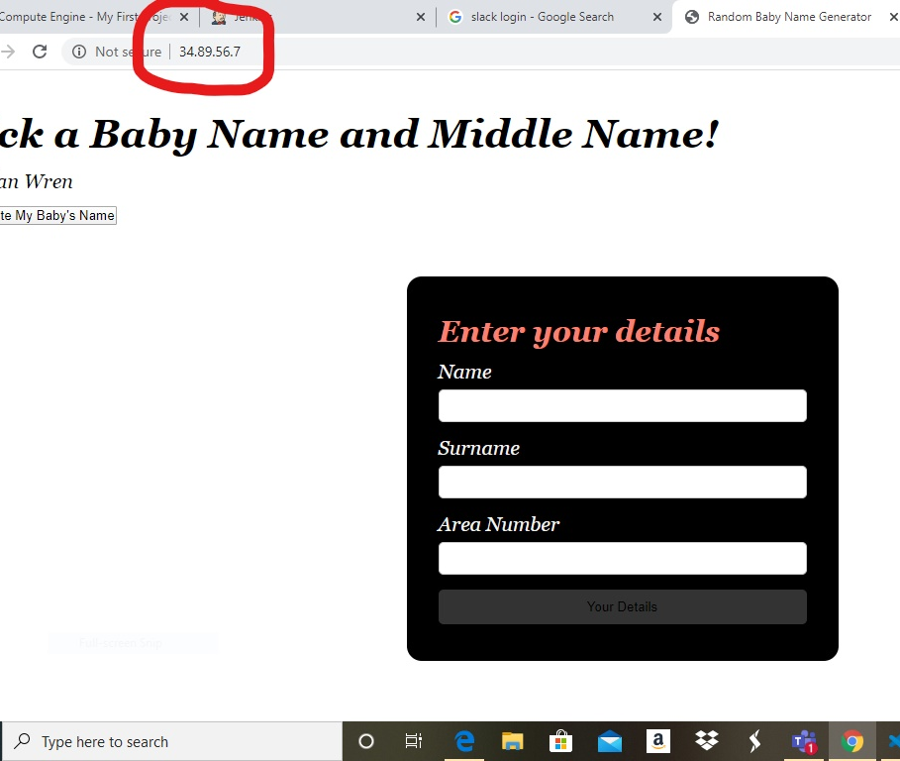
Worker Node (gcp)
Notes:
- Running on Nginx

Slide 17
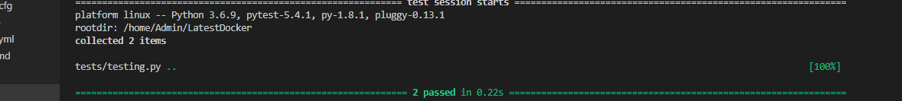
Testing
Here pytest was implemented in hand with coverage. these tools help me to see if my URLs worked and if my database was functioning. It showed me which passed and which did, and the over percentage of success.
Notes:
- Test passed

Slide 18
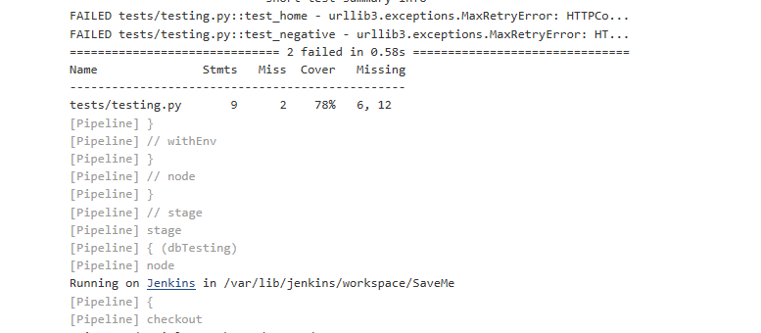
Testing on Jenkins
Notes:
- Here shows the testing on Jenkins which passed at 78% for this section

Slide 19
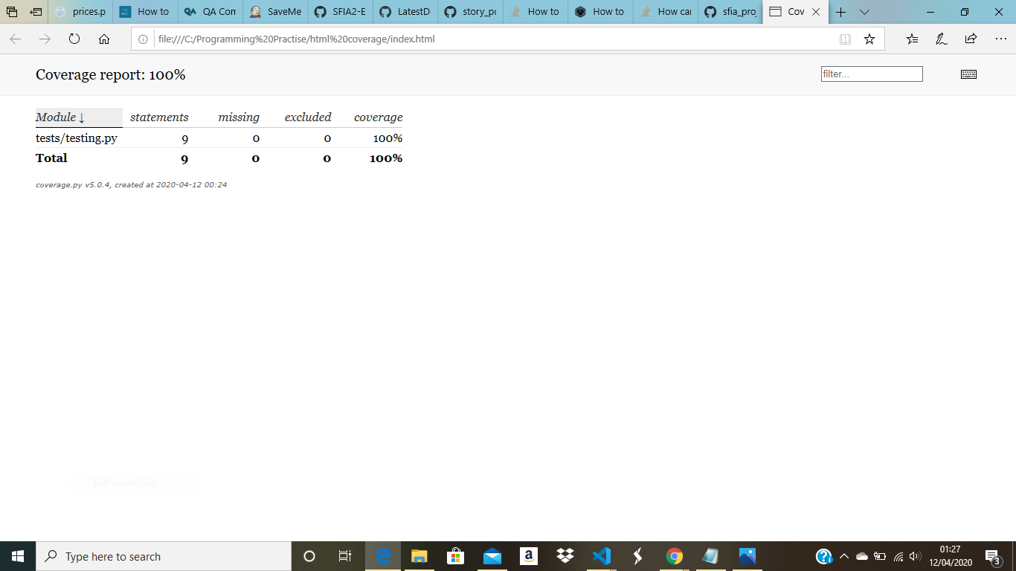
Database Testing and full coverage report
Notes:
- Here shows the overall coverage which shows 100%
- Explain with finding the coverage with source and without source which passed at 46%

Slide 20
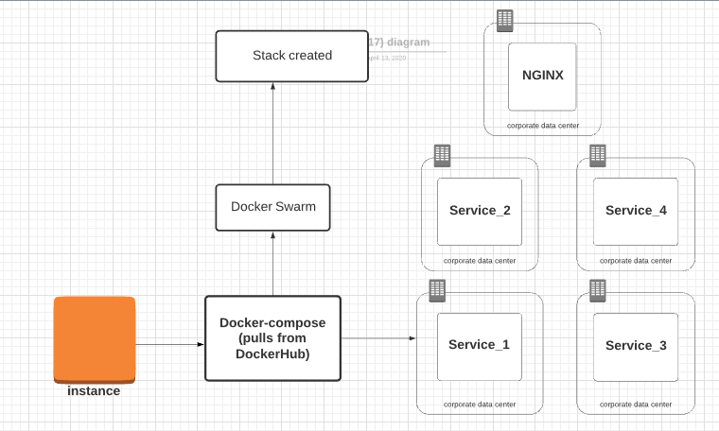
Project Architecture
Notes:
- Process 1 explain

Slide 21
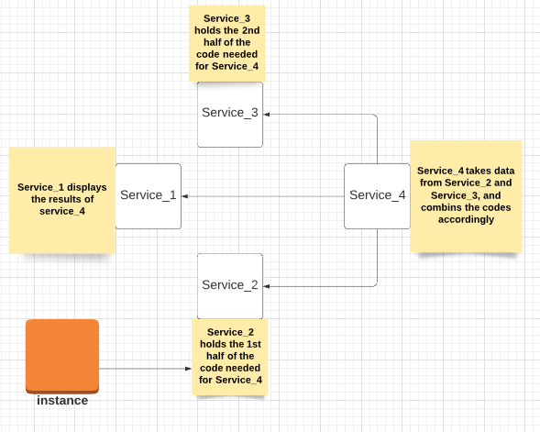
Project Architecture
Notes:
- Process 2 explain

Slide 22
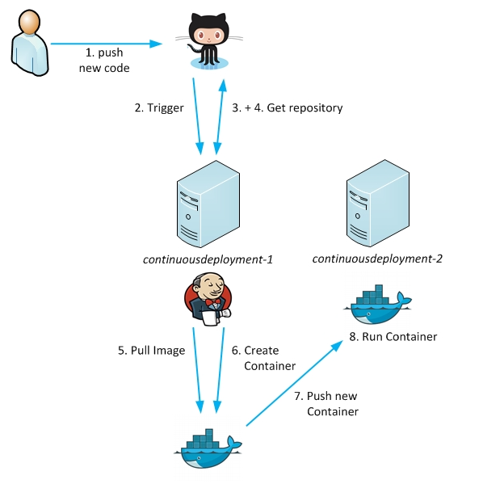
Deployment - JENKINS & GIT
Notes:
- This is a Jenkins integration server as a trigger. A push in our repository will trigger the Jenkins server so that we are able to get a Docker environment.

Slide 23
Technologies used
GCP Database Engine - Database
Python - Logic
Dockerhub
Jenkins - CI Server
Git - VCS
Trello - Project Tracking

Slide 24
Retrospective
Achievements
What was good was that everything was delivered within the timeframe even though there was issue involved.
Understanding the tools used in depth, understanding each had their own unique part and knowing the side effects without them.
All compulsory tasks were met.

Slide 25
Retrospective
Problems faced
Not understand the tasks and tools at hand at the beginning of the project. This made it harder to start and plan on what I need to do.
VM failed twice which cause a quite a bit of a setback for me, as I could move fowards with the next task.
Notes:
OTHER THINGS INCLUDED:
When trying to run the VM with 'allowing HTTP traffic' on the firewall rules, it keep make an error, which caused me to keep create new instances.
One the VM was fixed I had to catch up rather quickly, which cause me to do all nighters, this cause physical strain on my back and eyes.

Slide 26
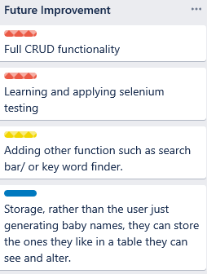
Improvements for the Future
Notes:
- Explain (Don't forget coloured labels)
- Firewall: Due to the fact that the IP address kept altering made it more difficult to implement. In addition, add HTTP traffic to the firewall rules without the VMs producing an error.

Slide 27
References
(2020), Steffi, 'Learning Continuous Deployment', https://learning-continuous-deployment.github.io/docker/jenkins/git/2015/04/21/getting-started/
Data Accessed: 14/04/2020

Slide 28
Authors
Shana Charlery

Slide 29
Acknowledgements
QA consulting and our fantastic instructors
The rest of our wonderful cohort on the programme

